Slide 1
Datawarehousing with db2 warehouse
Cloud_Phase 2

Slide 2
Revolutionizing Data Management
In this presentation, we will explore how DB2 Warehouse can transform your data warehousing capabilities.
We willdiscuss the benefits of using DB2Warehouse
its key features, and how it can help you achieve better business outcomes.

Slide 3
Introduction to Data Warehousing
Data warehousing is a critical component of modern data management.
It involves collecting and storing large amounts of data from various sources

Slide 4
Db2 Warehouse Overview
Db2 Warehouse is a cloud-based data warehousing solution that provides high-performance analytics and machine learning capabilities.
It is designed to handle large volumes of structured and unstructured data from various sources, and can be deployed on-premises or in the cloud.

Slide 5
Data Ingestion and Integration
Data Ingestion
Db2 Warehouse provides a variety of options for data ingestion, including batch, real-time, and streaming data.
Data Integration
Db2 Warehouse offers a range of tools for data integration, including ETL (extract, transform, load) processes, data quality checks, and data transformations.

Slide 6
Data Management and Governance
Data Quality and Security
Data quality is critical for effective decision making. Db2 Warehouse provides features such as data profiling, cleansing, and validation to ensure data accuracy.
Data Cataloging
Db2 Warehouse includes a data catalog that allows users to easily discover and understand available data assets.

Slide 7
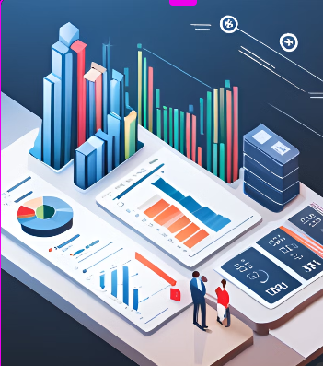
Analytics and Machine Learning
Db2 Warehouse offers advanced analytics and machine learning capabilities to help businesses make data-driven decisions.

Slide 8
Real-World Use Cases
Db2 Warehouse has been used by a variety of organizations across industries to gain valuable insights from their data.
Healthcare: Analyzing patient data to improve healthcare outcomesRetail: Optimizing inventory and improving customer experienceFinance: Fraud detection and risk managementTransportation: Optimizing routes and reducing costs

